Slide 1
12. Software Quality Assurance and Quality Management
CSE3203: Software Engineering

Slide 2
Discussion Topics
Software Quality Assurance
What are SQA, SQP, SQC, and SQM?
Elements of Software Quality Assurance
SQA Tasks, Goals, And Metrics
Quality Management and Software Development
QA Vs QC
Reviews and Inspections
An Inspection Checklist

Slide 3
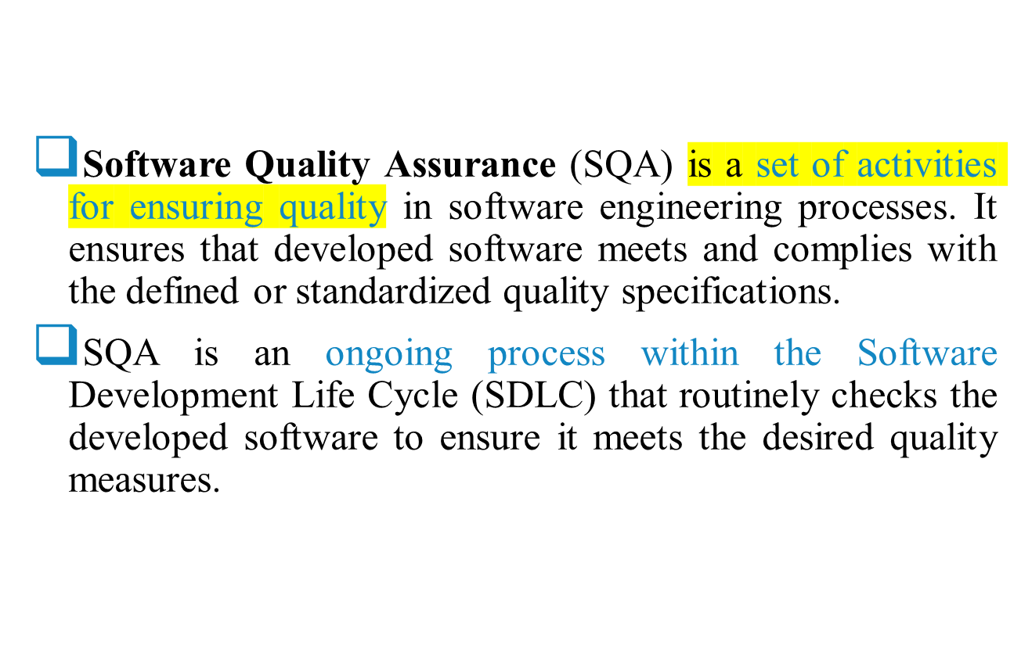


Software Quality Assurance

Slide 4


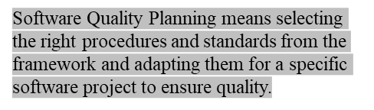
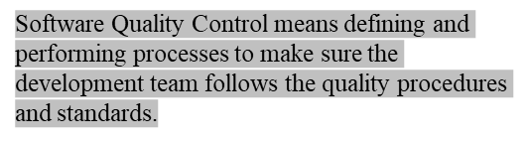
Software Quality Assurance – establishment of network of organizational procedures and standards leading to high-quality software.
Software Quality Planning – selection of appropriate procedures and standards from this framework and adaptation of these to specific software project
Software Quality Control – definition and performing of processes that ensure that project quality procedures and standards are being followed by the software development team
Software Quality Metrics – collecting and analyzing quality data to predict and control quality of the software product being developed

Slide 5





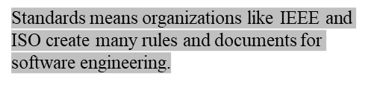
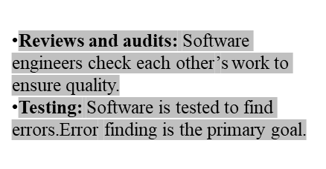
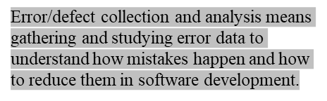
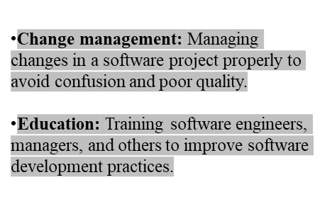
Standards. The IEEE, ISO, and other standards organizations have produced a broad array of software engineering standards and related documents.
Reviews and audits. Technical reviews are a quality control activity performed by software engineers for software engineers.
Testing. Software testing is a quality control function that has one primary goal—to find errors.
Error/defect collection and analysis. The only way to improve is to measure how you’re doing. SQA collects and analyzes error and defect data to better understand how errors are introduced and what software engineering activities are best suited to eliminating them.
Change management. Change is one of the most disruptive aspects of
any software project. If it is not properly managed, change can lead to confusion, and confusion almost always leads to poor quality.
Education. Every software organization wants to improve its software
engineering practices. A key contributor to improvement is education of software engineers, their managers, and other stakeholders.

Slide 6

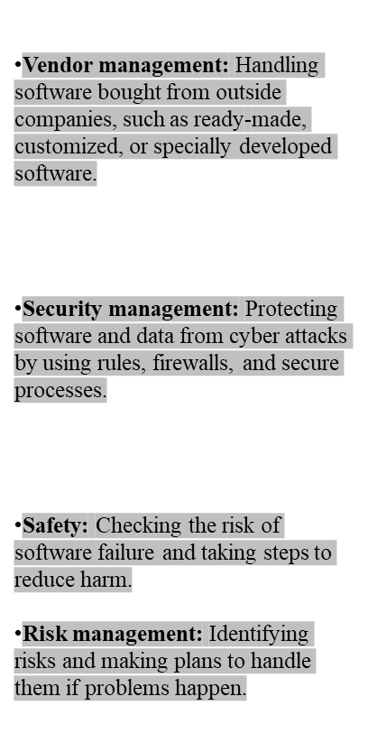
Vendor management. Three categories of software are acquired from external software vendors—shrink-wrapped packages (e.g., Microsoft Office), that is custom tailored to the needs of a purchaser, and contracted software that is custom designed and constructed from specifications provided by the customer organization.
Security management. With the increase in cyber crime and new government regulations regarding privacy, every software organization should institute policies that protect data at all levels, establish firewall protection for WebApps, and ensure that software has not been tampered with internally. SQA ensures that appropriate process and technology are used to achieve software security.
Safety. SQA may be responsible for assessing the impact of software failure and for initiating those steps required to reduce risk.
Risk management. Risk management activities are properly conducted and that risk-related contingency plans have been established

Slide 7
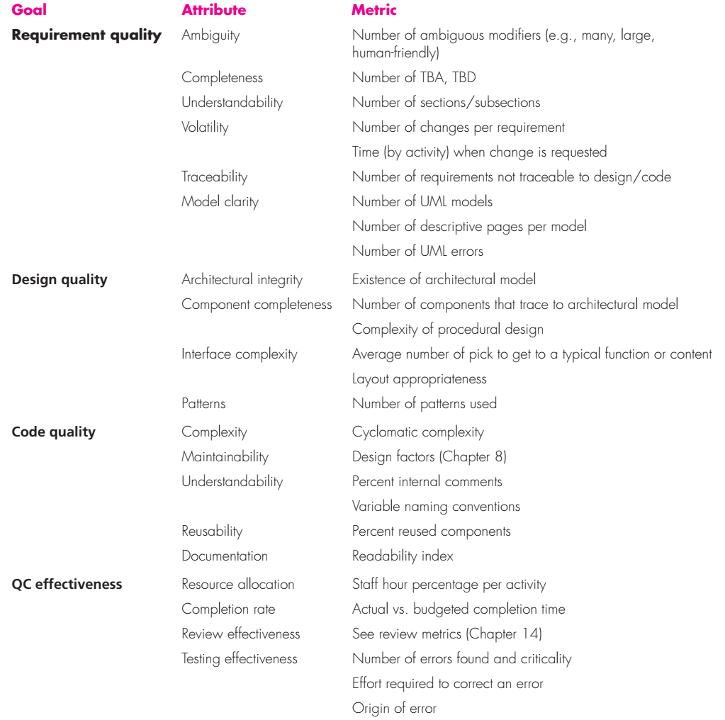




SQA Tasks, Goals, And Metrics

Slide 8


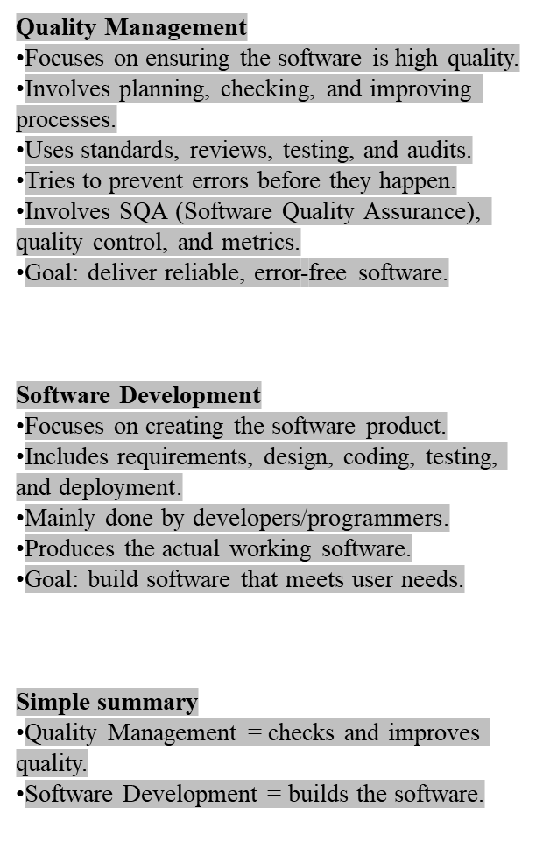
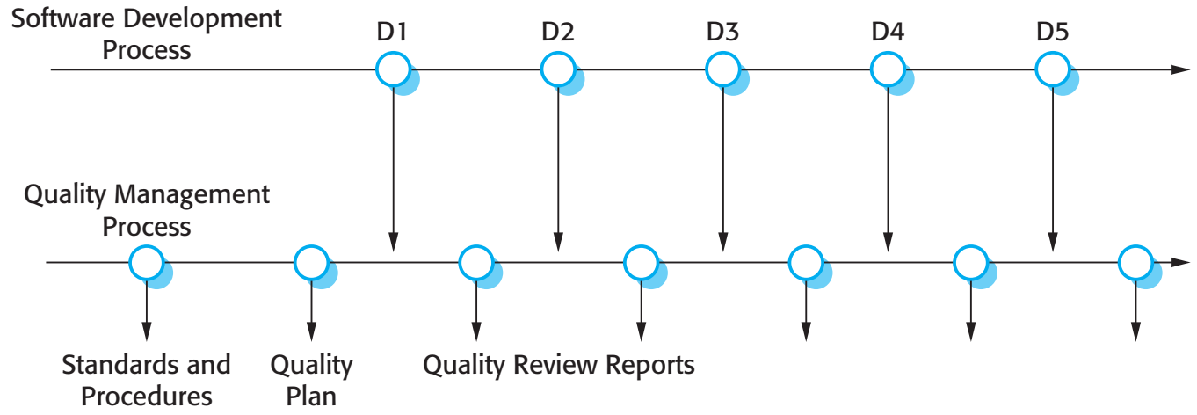
Quality Management and
Software Development
Quality management provides an independent check on the software development process.
The quality management process checks the project deliverables to ensure that they are consistent with organizational standards and goals.
QA team should be independent from the development team so that they can take an objective view of the software. This allows them to report on software quality without being influenced by software development issues.

Slide 9
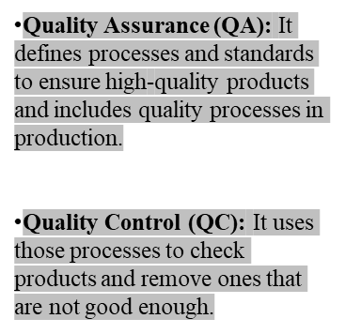
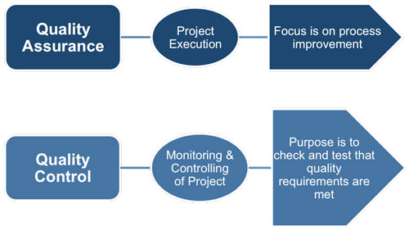
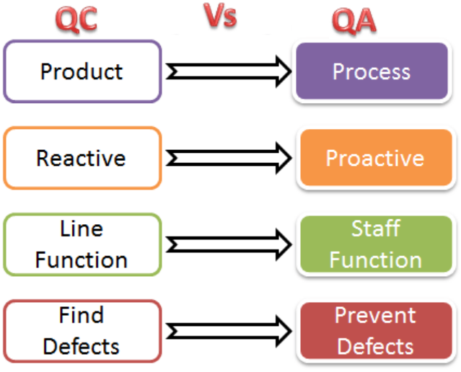
Quality Management
The terms ‘quality assurance’ and ‘quality control’ are widely used in manufacturing industry.
Quality Assurance (QA) is the definition of processes and standards
that should lead to high-quality products and the introduction of quality processes into the manufacturing process.
Quality Control(QC) is the application of these quality processes to weed out products that are not of the required level of quality.

Slide 10
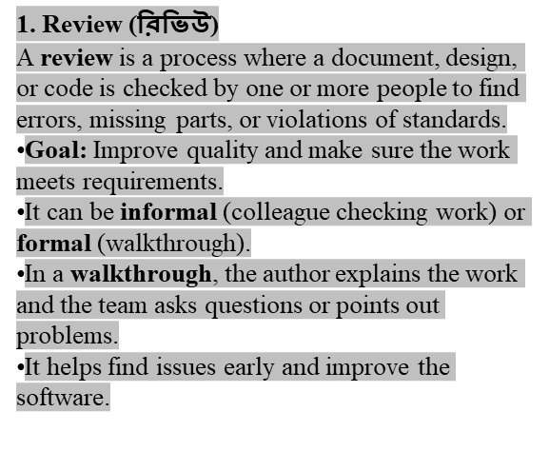

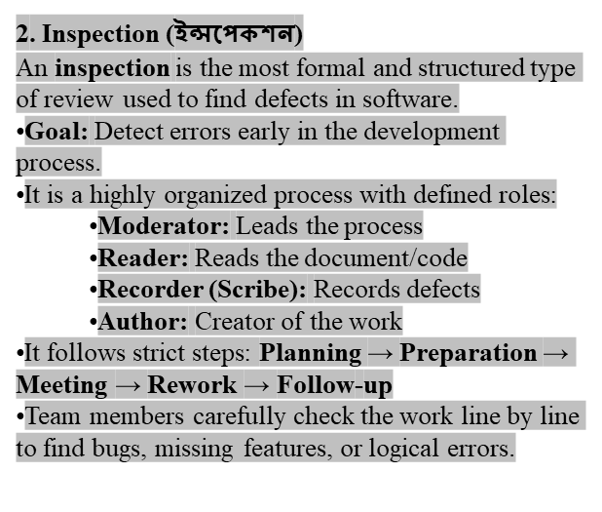
Reviews and Inspections
Reviews and inspections are QA activities that check the quality of project deliverables. This involves examining the software, its documentation and records of the process to discover errors and omissions and to see if quality standards have been followed.
During a review, a group of people examine the software and its associated documentation, looking for potential problems and non-conformance with standards. The review team makes informed judgments about the level of quality of a system or project deliverable. Project managers may then use these assessments to make planning decisions and allocate resources to the development process.
Program inspections are ‘peer reviews’ where team members collaborate to find bugs in the program that is being developed.
Program inspections involve team members from different backgrounds who make a careful, line-by-line review of the program source code. They look for defects and problems and describe these at an inspection meeting. Defects may be logical errors, anomalies in the code that might indicate an erroneous condition or features that have been omitted from the code. The review team examines the design models or the program code in detail and highlights anomalies and problems for repair.
During an inspection, a checklist of common programming errors is often used to focus the search for bugs. This checklist may be based on examples from books or from knowledge of defects that are common in a particular application domain.

Slide 11
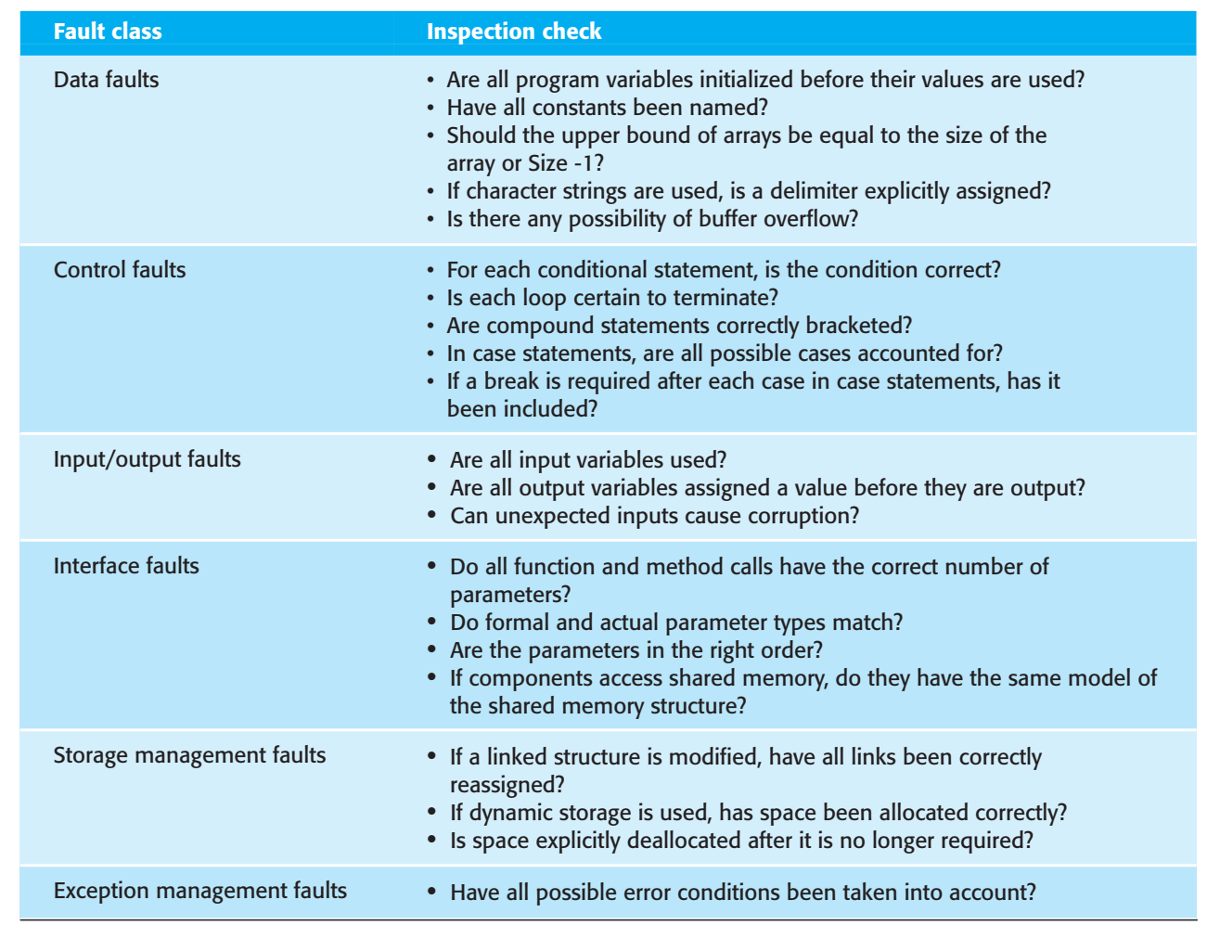
An Inspection Checklist

Slide 12
References:
  Software Engineering A practitioner’s Approach
  by Roger S. Pressman, 7th edition, McGraw Hill, 2010.
  2. Software Engineering by Ian Sommerville,
  9th edition, Addison-Wesley, 2011

